Slide 1

Real Time Dual-Mode Fish Disease Detection Based on Hybrid Deep Learning Framework
Presented By
Supervisor
ID: 2014751037
ID: 2014751050
ID: 2014751069
ID: 2014751147
Ferdaus Anam Jibon
Assistant Professor
Department of CSE
UITS, Dhaka
Azharul Islam
Tamanna Akter Mim
Fahmida Nasrin
Sanzida Akter Chadne

Slide 2
Outline
Introduction
Literature Review
Problem Statement
Contribution
Proposed Methodol
Experiment
Result Analysis
Application and Limitations
Conclusion
1

Slide 3
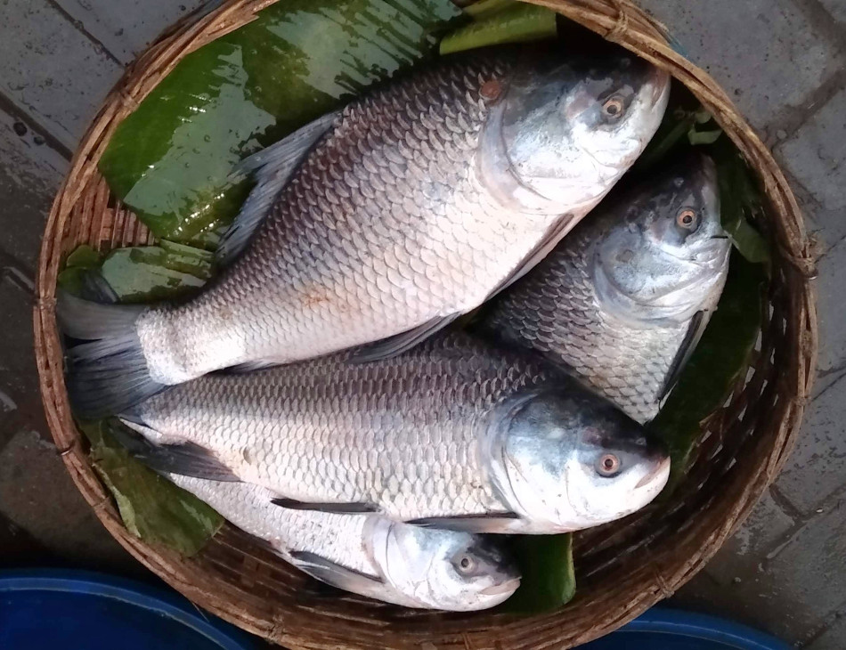
Introduction
Currently, fish accounts for nearly 20% of the animal protein consumed by 3.2 billion people.
Over 18 million people in Bangladesh depend on the fisheries industry for their livelihoods.
Several economically valuable by-products are produced by fish. These by-products include fish glue, oil, meat, and fertilizer.
Provides an essential source of high-quality protein, nourishing the human body for optimal health.
Fig 1: Healthy Fish
2

Slide 4
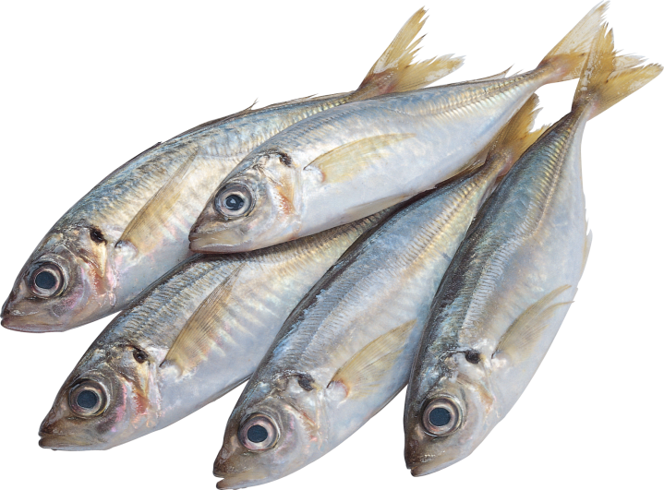
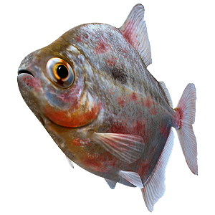
Introduction
Fish Disease
Epizootic Ulcerative Syndrome (EUS)
Fin and Tail Rot
Mouth Fungus
Tuberculosis
Dropsy
Ulcer
Fungus (Saprolegnia)
Neon Tetra Disease
Columnaris disease
Fig 2: Healthy Fish
Fig 3: Unhealthy Fish
3

Slide 5
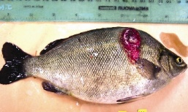
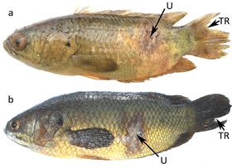
Introduction
Epizootic Ulcerative Syndrome (EUS) is a devastating fish disease caused by the fungus Aphanomyces invadans.
Fin and Tail Rot is caused by several types of gram-negative bacteria and it will eventually kill the diseased fish and infect all other fish in the aquaculture.
Fig 4: Epizootic Ulcerative Syndrome (EUS)
Fig 5: Fin and Tail Rot
4

Slide 6
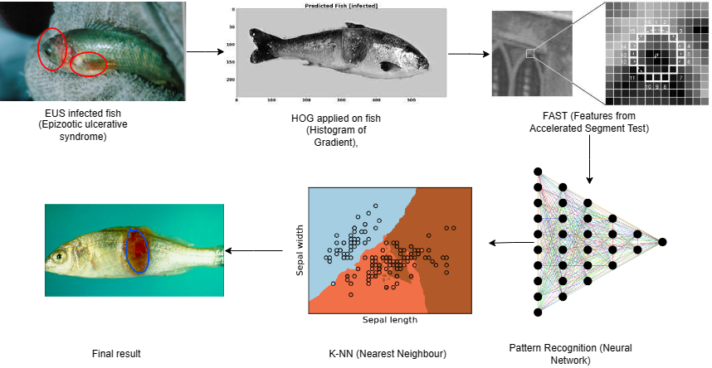
Related Work- 1
Fig 6: Architecture of K-NN(K-Nearest Neighbors)
Reference :Image Processing Techniques for Identification of Fish Disease. National Bureau of Fish Genetic Resources (NBFGR, Lucknow) and ICAR-Central Inland Fisheries Research Institute (CIFRI), Kolkata. Thanks to Dr. A.K Sahoo(CIFRI, Kolkata) and Dr .P.K Pradhan (NBFGR,Lucknow), 2018.
5

Slide 7
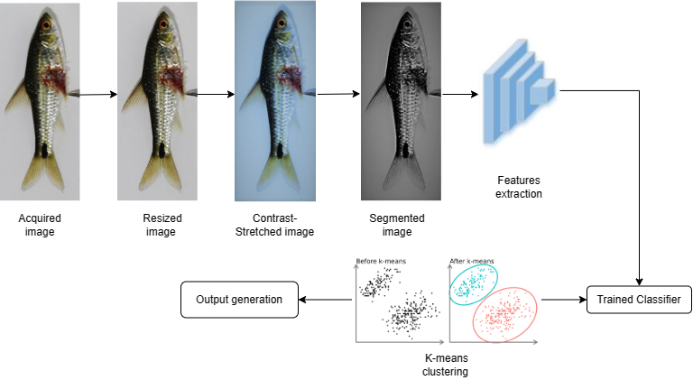
Related Work- 2
Fig 7: Architecture of K-Means Clustering
Reference :An in-depth automated approach for fish disease recognition. Md. Jueal Mia ª, Rafat Bin Mahmud ª, Md. Safein Sadad ª, Hafiz Al Asad ª, Rafat Hossain ^{b} , December 2019.
6

Slide 8
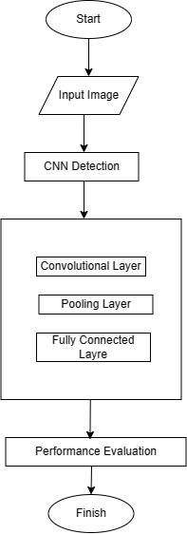
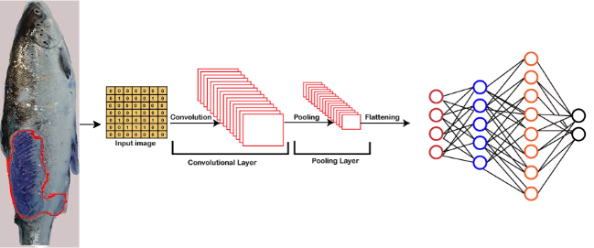
Related Work- 3
Fig 8: Architecture of CNN
Fig 9: Flowchart
Reference :FISH DISEASE DETECTION OF EPIZOOTIC ULCERATIVE SYNDROME USING DEEP LEARNING IMAGE PROCESSING TECHNIQUE. Proceedings of the 9th International Conference on Fisheries and Aquaculture, Vol. 8, Issue 1, 2023, pp. 23-34 Copyright © 2023 Author(s)ISSN 2386-1282.
7

Slide 9
Problem Statement
High dimensionality in image can interfere to identify the irregularity of the affected part of the fish body.
2. Risk of overfitting, where the model learns noise from the training data and doesn't perform well.
3. It can be difficult to identify complex shape and overlapping region. If the segmentation process isn't accurate, it could affect the quality of extracted features and subsequent classification.
8

Slide 10
Contribution
Use a CNN-based hybrid model to Figure out health states in fish, specifically identifying EUS illness and fin/tail rot and find maximum accuracy of 98.99%.
Develop an Ensemble with voting, integrating Xception, VGG16, and Densenet169.
Leveraged edge detection techniques, including Canny, Prewitt, Robert, Sobel, and Marr-Hildreth to extract meaningful edges.
9

Slide 11
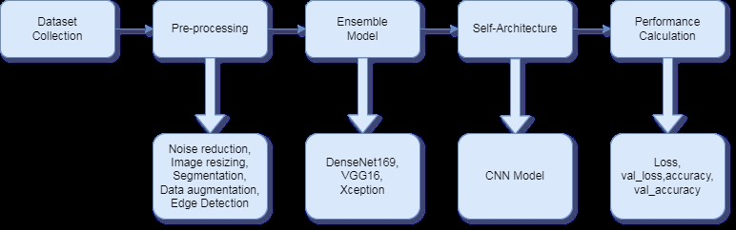
Methodology
Fig : Details Methodology of Ensemble model
13

Slide 12
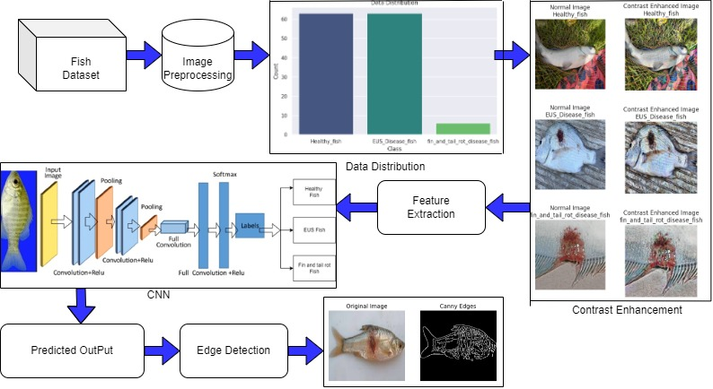
Methodology
Fig : Details Methodology of CNN model
13

Slide 13
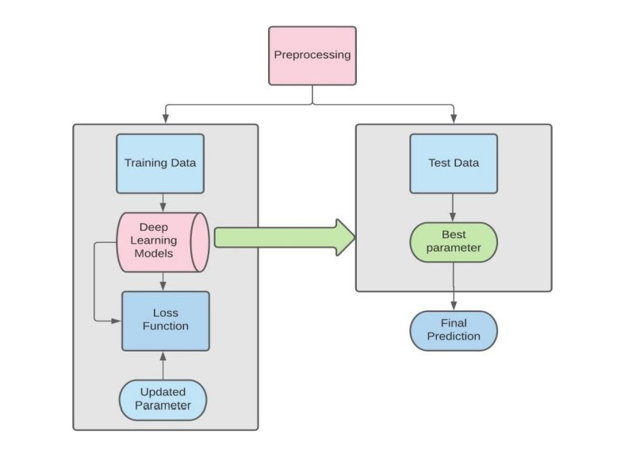
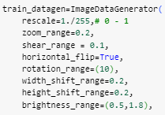
Image Preprocessing
Image Resizing: 224 x 224
Segmentation: Divide an image into meaningful segments or regions, which can aid in object recognition.
Data Augmentation: Introduce variations through rotations, flips, and crops, zoom range, shear range, horizontal flip.
Noise Reduction: Implement filters for reduced noise and artifact suppression through contrast enhancement.
Edge Detection: Apply filters (Sobel, Canny, Prewitt , Robert, Marr-Hildreth) to highlight edges and important features.
Fig 14: Image preprocessing Technique
14

Slide 14
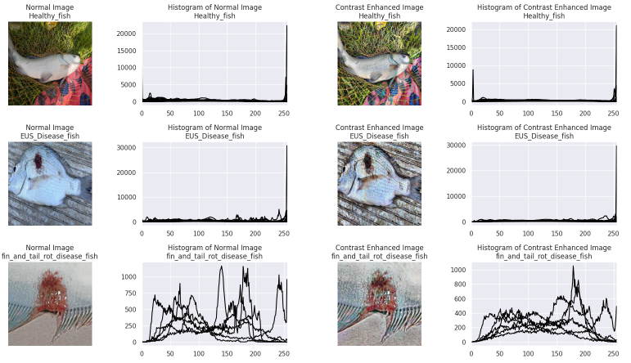
Image Preprocessing
Noise Reduction: Contrast enhancement.
Fig : Histogram of Normal Image VS Contrast Enhanced Image
14

Slide 15
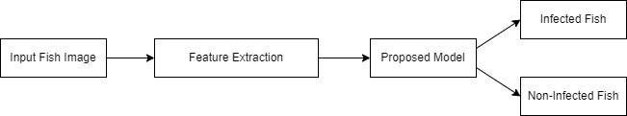
Feature Extraction
We consider two types of feature extraction techniques: one is statistical features, and another one is grey-level co-occurrence matrix (GLCM) features based on interpreting fish diseases.
Dimensionality Reduction
Pattern Recognition
Preprocessing and Normalization
Reduced Data Storage Requirements
15

Slide 16
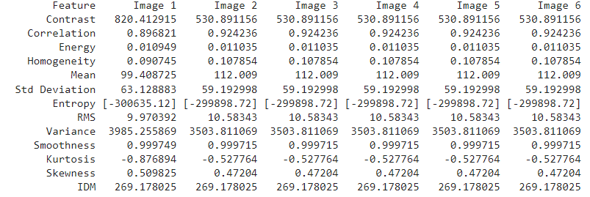
Feature Extraction
Figure : Extracted the feature for 10 Fish Images
15

Slide 17
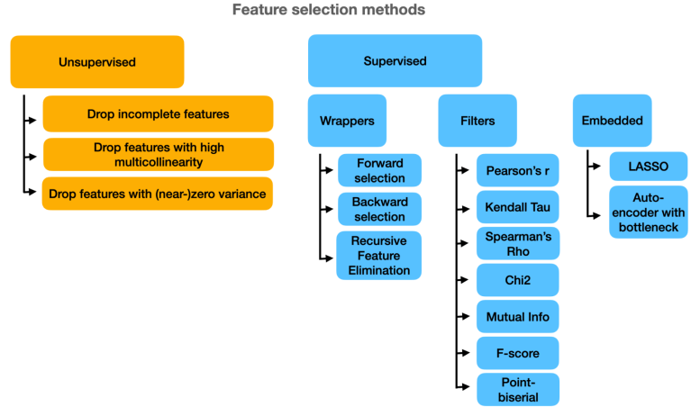
Feature Selection
Fig 15: Feature Selection Techniques of Image
16

Slide 18
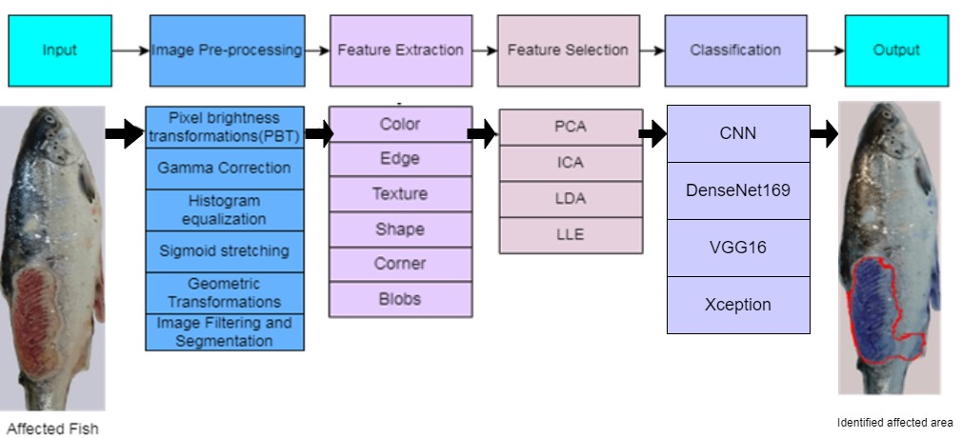
Our Model
Figure : Demonstration of our model
19

Slide 19

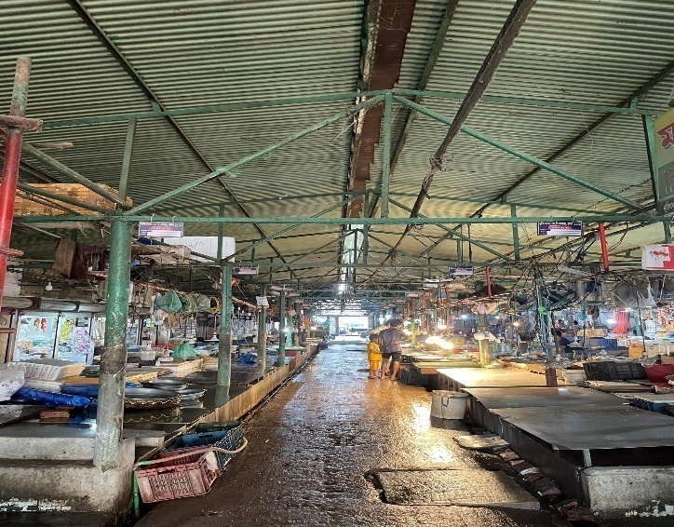
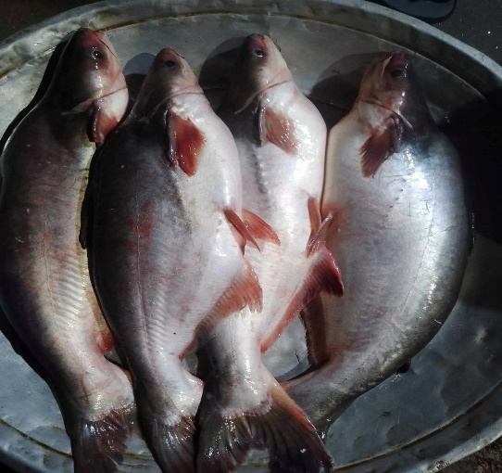
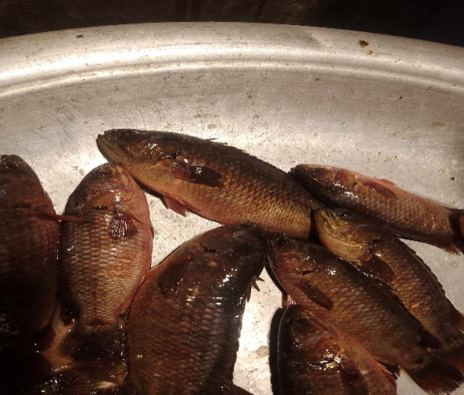
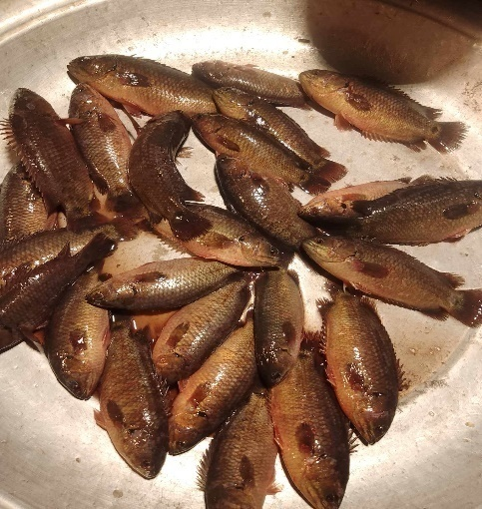
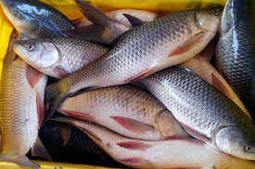
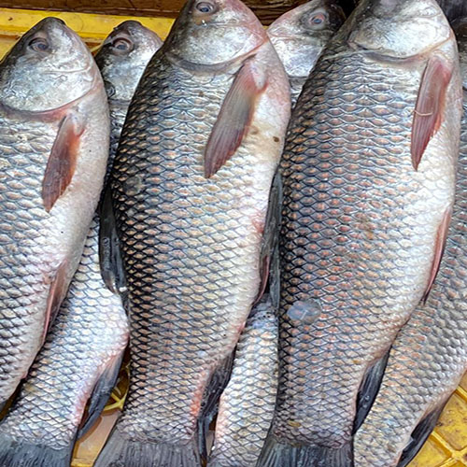
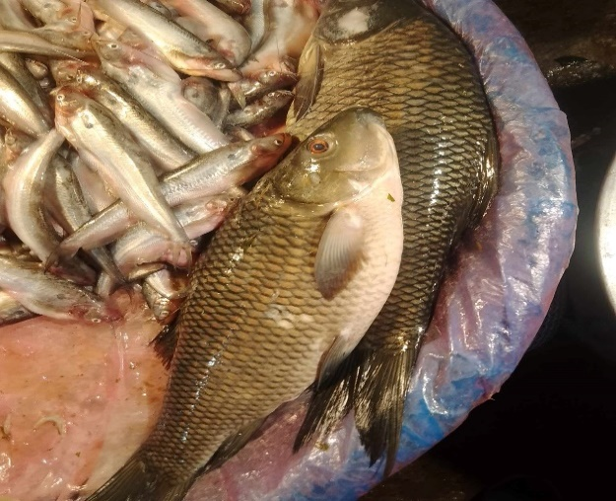
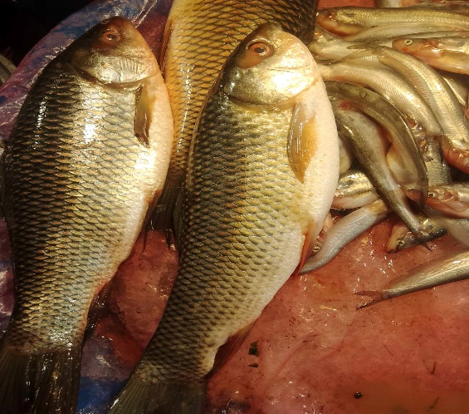
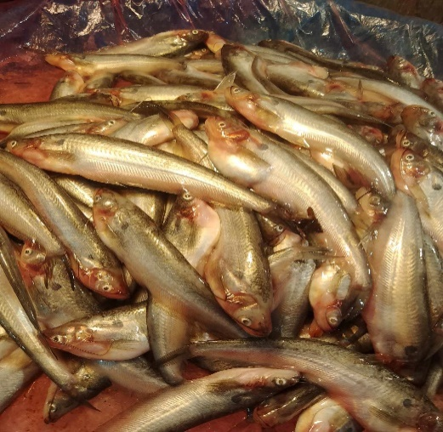
Dataset
Primary Dataset - I
21

Slide 20
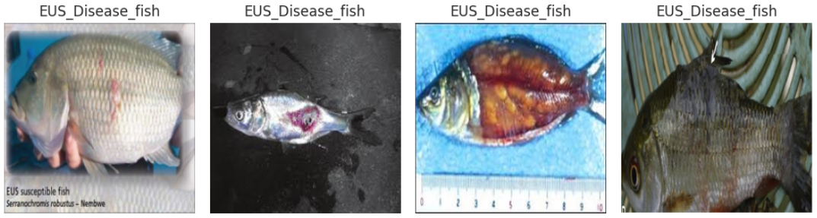
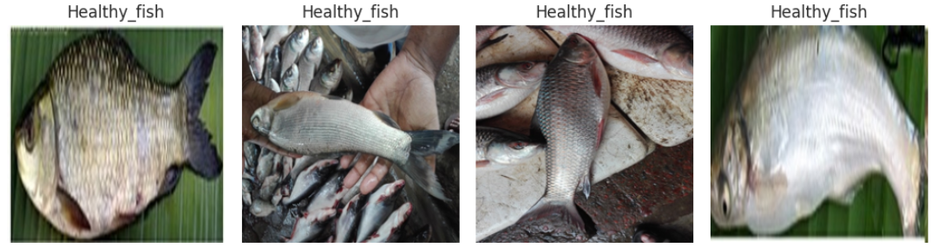
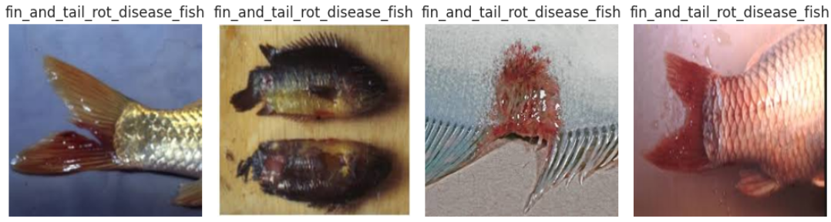
Dataset
Primary Dataset - II
21

Slide 21
Dataset
Secondary Dataset
Fresh water fish disease dataset
The Sunamganj Community Based Resource Management Project (CBRMP). It contains a total of 126 fish species from 39 families found in the Sunamganj haor area. CBRMP has promoted community-based fisheries management approaches that, along with their livelihoods focus, are helping to preserve and enhance natural fish stocks in the hoar basin. World Fish support to LGED involves several areas including monitoring the impacts of CBRMP on fish catch, bio-diversity and livelihoods. Apart from pond fisheries, fisheries of haors play a very important role in the livelihood earning of haor people. Large areas of Sylhet, Mymensingh, Sunamganj, Habiganj, MoulviBazar, Kishoreganj and Netrokona districts are covered by many haors. The haor basin has its commercial and ecological importance for fish production. This feature presents some photographs of Epizootic Ulcerative Syndrome (EUS) or Red Spot disease affected fishes of different beels of Sunamganj haor area.
We have taken 90% images from our dataset for Training and 10% for Testing.
22

Slide 22
Experiment
Tools and Hyperparameter
Software or Hardware | Specification
CPU | Intel Core i7-12700
GPU | GeForce RTX 3060 Ti
RAM | DDR4 32 GB
Python | 3.10
PyTorch | 2.0
Hyperparameters | Values
Learning Rate | 0.001
Batch Size | 32/64
Activation Function | ReLu/Sigmoid/Tanh/Softmax/ ELU/Swish etc.
Optimizer | Adam/RMSprop/Adagrad/Adadelta/ NAdam/AMSGrad/L-BFGS etc.
Number of Epochs | 10
Loss Function | Binary Cross-Entropy/Mean Absolute Error/Mean Squared Error/ Categorical Cross-Entropy etc.
Dropout Rate | 0.2
Image Size orInput Shape | (224,224, 3)
Number of Neurons or Units | 256
Class Weights | ImageNet
Table 1 : Environment Setup
Table 2: Hyperparameter
20

Slide 23
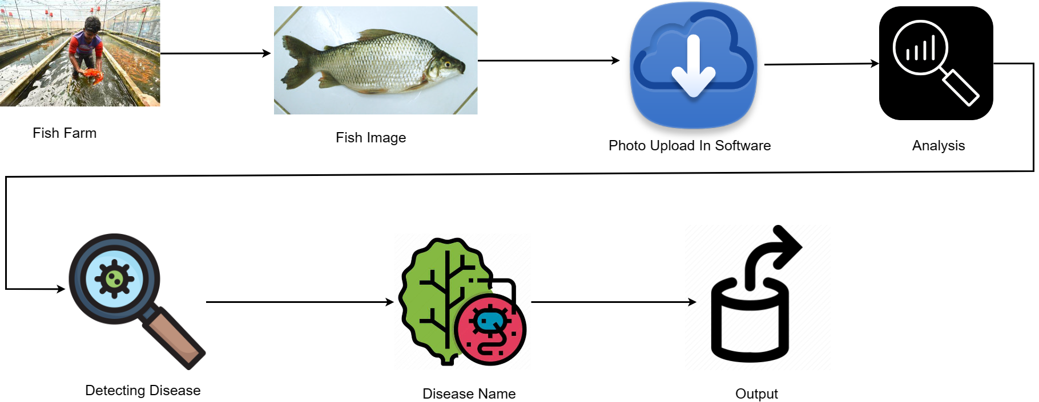
Experiment
Fig 18 : Flowchart To Detect Fish Disease
23

Slide 24
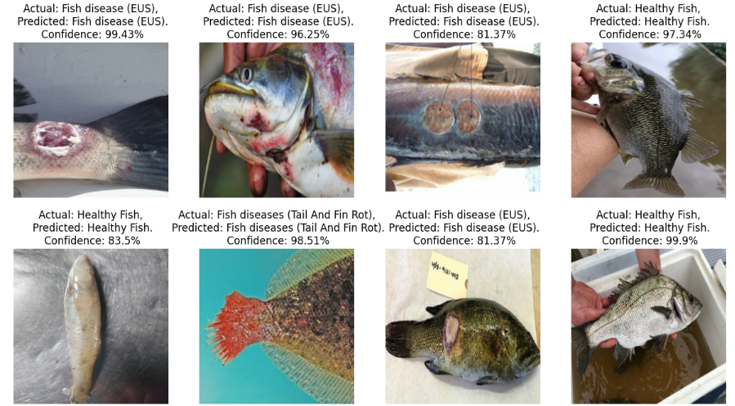
Experiment
Fig : Fish Image Prediction
23

Slide 25
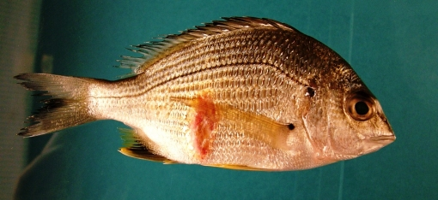
Findings-1 (EUS)
Tailored Species Understanding: Our initiative delves comprehensively into the intricacies of Epizootic Ulcerative Syndrome (EUS) in fish, acknowledging its diverse expressions across distinct aquatic species.
Advanced Grading of Severity: Our cutting-edge model surpasses mere EUS detection; it introduces a sophisticated severity grading system. This innovation not only pinpoints EUS cases but also assigns precise severity scores.
Real-Time Alerts for Immediate Action: With real-time alerts as a cornerstone of our approach, we empower fish farmers and aquaculturists to initiate immediate responses upon detecting EUS signs.
Unceasing Evolution through Continuous Learning: Our model’s capabilities evolve perpetually, driven by an unending learning process fueled by emerging EUS cases.
Fig 16: EUS Disease in Fish.
17

Slide 26
Findings-2 (Fin and Tail Rot)
Accuracy in Detection: Our methodology excels in accurately identifying instances of fin and tail rot fish disease, ensuring that positive cases are pinpointed with precision.
Swift Analysis: Our system operates with exceptional efficiency, swiftly analyzing images and delivering highly accurate outcomes without causing undue delays.
Prompt Prevention: The approach we employ facilitates swift actions by fish farmers to isolate affected aquatic organisms.
Fig 17: Fin and Tail Rot Disease in Fish.
18

Slide 27
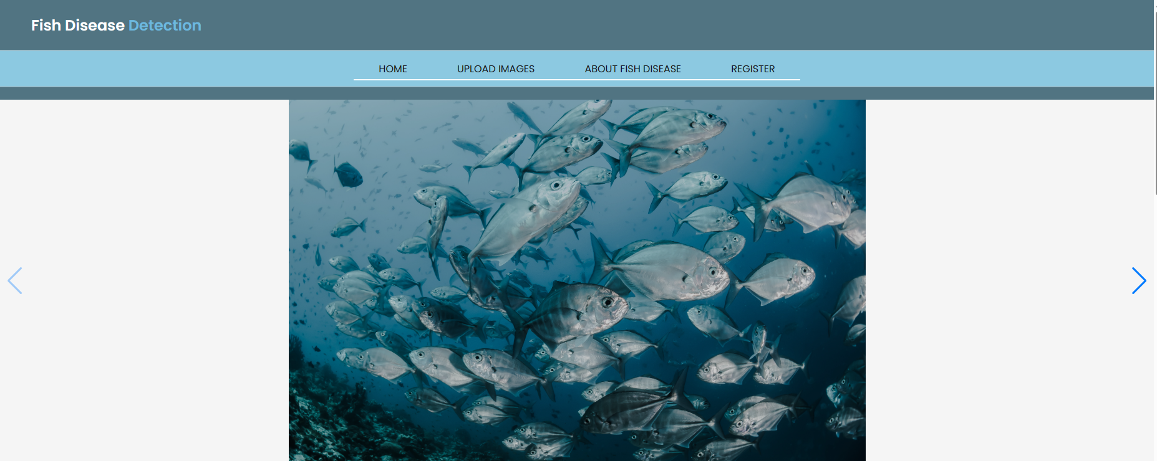
Interface
24

Slide 28

Interface
25

Slide 29

Interface
26

Slide 30
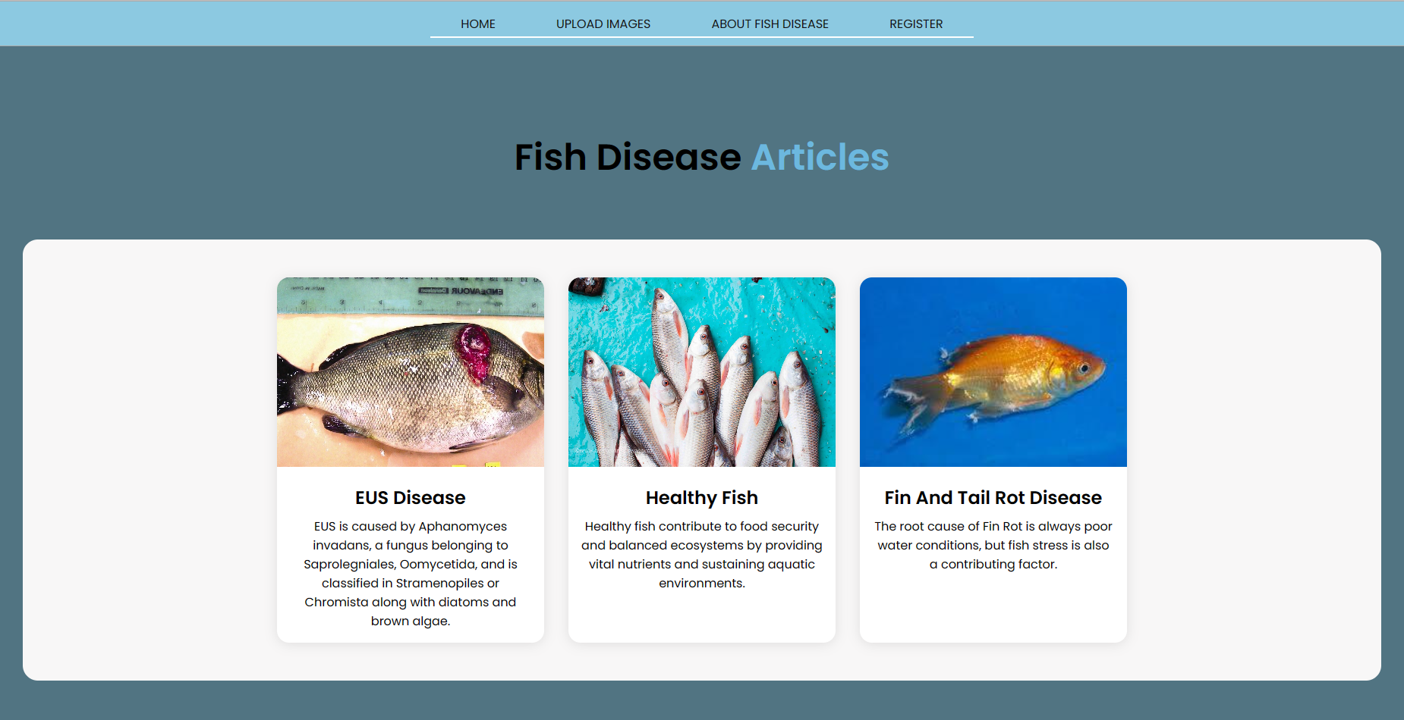
Interface
27

Slide 31
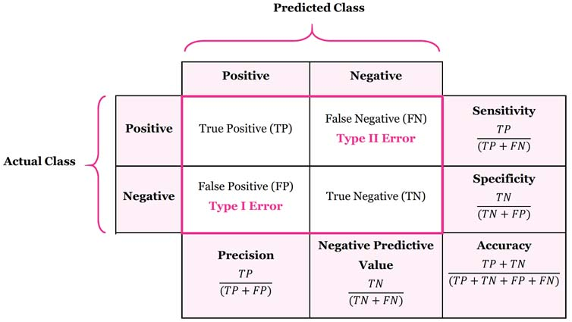
Result Analysis
We use edge detection techniques, basic Convolutional Neural Network (CNN), Ensemble with voting combining Xception, VGG16, and Densenet169.
Table : Confusion Matrix of Model Performance
30

Slide 32
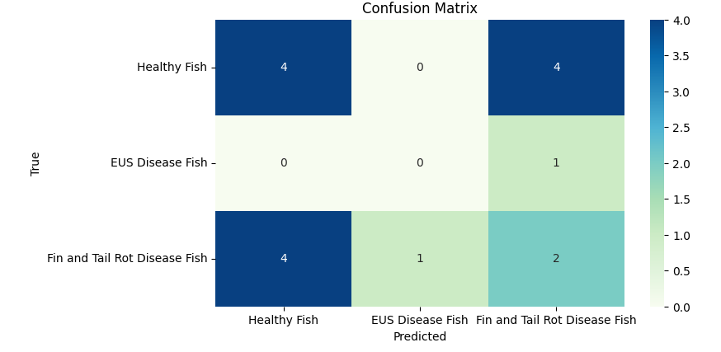
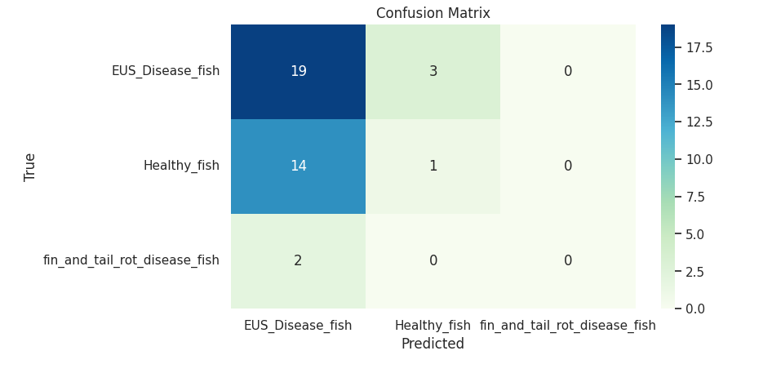
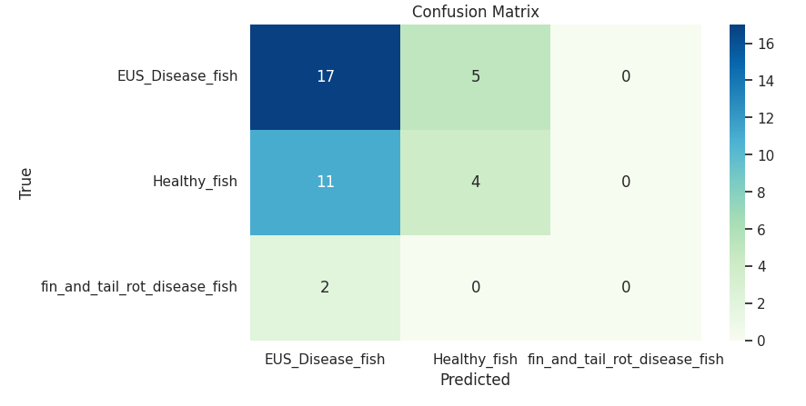
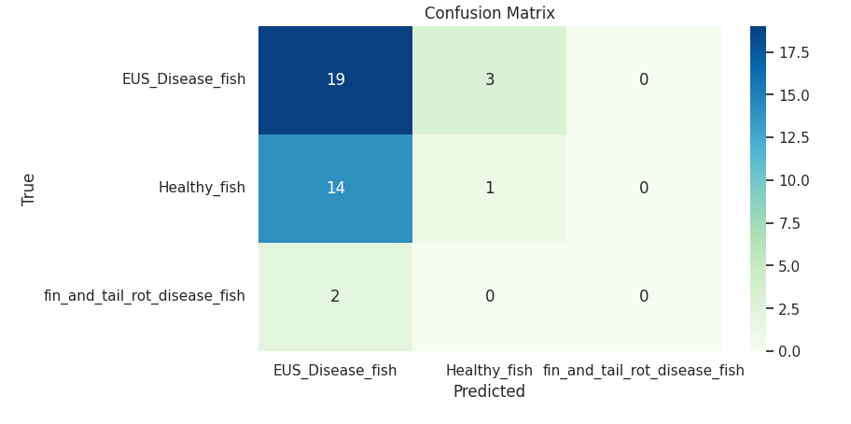
Result Analysis
CNN
DenseNet169
VGG16
Xception
Figure: Confusion Matrix of model performance
30

Slide 33
Result Analysis
Method | Accuracy | Validation Loss | Validation Accuracy
CNN | 98.99% | 0.64% | 94.7%
Densnet169 | 96.5% | 0.77% | 71%
Vgg16 | 60% | 0.86% | 90.3%
Xception | 86% | 1. 37% | 51%
Table: Result Analysis
30

Slide 34
Result Analysis
Table: Result Analysis of related work
30

Slide 35
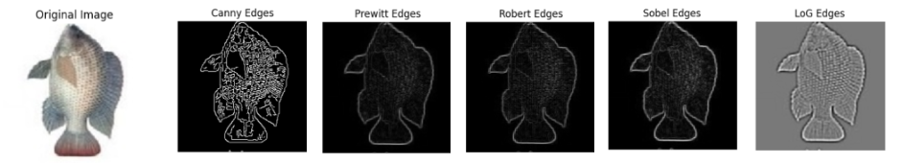
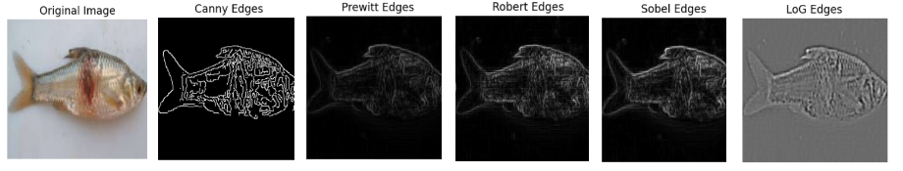
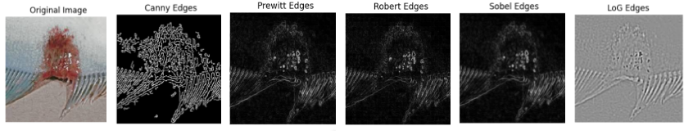
Result Analysis
Normal Fish
EUS Disease
Fin and Tail Rot
Disease
Figure: Edge Detection Techniques
30

Slide 36
Limitations
Challenges in adapting to new fish data or environments.
Crucial testing needed for reliable performance in different scenarios.
33

Slide 37
Conclusion
Fish diseases can have significant economic and environmental impacts.
Developing effective disease detection methods can help prevent outbreaks, reduce fish mortality.
Allows for innovation in the field and contributes to cutting-edge research.
Analyzing fish health data can help develop skills in data processing, pattern recognition, and predictive modeling.
31

Slide 38
References
Image Processing Techniques for Identification of Fish Disease.National Bureau of Fish Genetic Resources (NBFGR,Lucknow) and ICAR-Central Inland Fisheries Research Institute (CIFRI), Kolkata. Thanks to Dr. A.K Sahoo(CIFRI, Kolkata) and Dr .P.K Pradhan (NBFGR,Lucknow).
An in-depth automated approach for fish disease recognition.Md. Jueal Mia ª, Rafat Bin Mahmud ª, Md. Safein Sadad ª, Hafiz Al Asad ª, Rafat Hossain ^{b}available online: https://www.sciencedirect.com/science/article/pii/S1319157822000672?fbclid=IwAR3so1x0EpgFVXfez842s7Ht5edYcmoYrxfIFXiFXfp1wu2d4KyGXZzyvMU
FISH DISEASE DETECTION OF EPIZOOTIC ULCERATIVE SYNDROME USING DEEP LEARNING IMAGE PROCESSING TECHNIQUEProceedings of the 9th International Conference on Fisheries and Aquaculture, Vol. 8, Issue 1, 2023, pp. 23-34 Copyright © 2023 Author(s)ISSN 2386-1282 online DOI: https://doi.org/10.17501/23861282.2023.8102
Advanced Techniques for the Intelligent Diagnosis of Fish Diseases: A Review Daoliang Li, Xin Li, Qi Wang, Yinfeng Hao Animals 12 (21), 2938, 2022 available online: https://www.mdpi.com/2076-2615/12/21/2938
Fish disease diagnosis system based on image processing of pathogens' microscopic images Jeong-Seon Park, Myung-Joo Oh, Soonhee Han 2007 Frontiers in the Convergence of Bioscience and Information Technologies, 878-883, 2007 available online: https://ieeexplore.ieee.org/abstract/document/4524222
Image processing technique to detect fish disease Hitesh Chakravorty, Rituraj Paul, Prodipto Das International Journal of Computer Science and Security (IJCSS) 9 (2), 121-131, 2015 available online: https://www.academia.edu/download/68087732/Image_Processing_Technique_To_Detect_Fish_Disease.pdf
32

Slide 39
Thank You!
33

